Slide 1
General Meeting: 06/16/2016

Slide 2
Special Guests
Anthony Vega, Chicago Shakespeare Theater
Andy Brecklin, Olive’s Garden for the Hungry
Chicago Metropolitan Agency for Planning (CMAP)

Slide 3
Committee Updates
Bylaws – Marie MacDonald, Chair
Community Development – Bill Bucher
Fundraising & Service – Sam Wertime, Chair
Livability & Attractiveness – Marie MacDonald
Social – Jenny Conlon

Slide 4
Bylaws
The JPF Bylaws have been completed in draft form.
They are available on the JPF website for public input http://www.jeffersonparkforward.org/committees/bylaws/
Input will be accepted through email at webmaster@jeffersonparkforward.org, through the website, social media or at the next general meeting.
The Board of Directors will keep the bylaws posted until after the next General Meeting (July 20) and will amend and adopt the Bylaws, likely in August.

Slide 5
Community Development
Yelp Drive
Higgins/Milwaukee Alley
Pub Nights/Book Club

Slide 6
Fundraising & Services
Gayle Nelson, Hands to Help, speaking in September

Slide 7
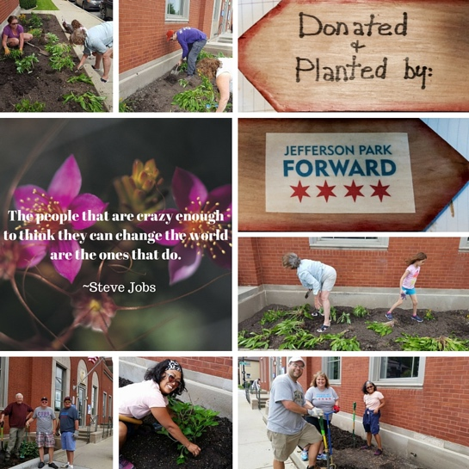
Livability & Attractiveness
Plant the Post Office
June 5 and 12

Slide 8
Social
Social Events (planned):
Summer Picnic – Sunday, 7/24 (tentative)
Bowling – Saturday, 10/15 or 10/22
Pub Crawl or Restaurant Crawl – Fall (TBD)
Other Event Ideas
Trivia Night (June/July)
Brunch at Galvins (August)
Sip and Paint event (November)
Holiday Happy Hour (November/December)

Slide 9
New Business
Austin Foster Playground Survey Results
On a scale of 5 (1 lowest, 5 highest)
Landscape – 3.85
Gametime – 3.72
Burke – 3.26
Dynamo – 2.40
Kompan – 1.77
224 responses received
73 comments through the survey, 10+ through email/website
Next Steps
FOTP will review with CPD
Construction in August/September

Slide 10
Austin/Foster Playground

Slide 11
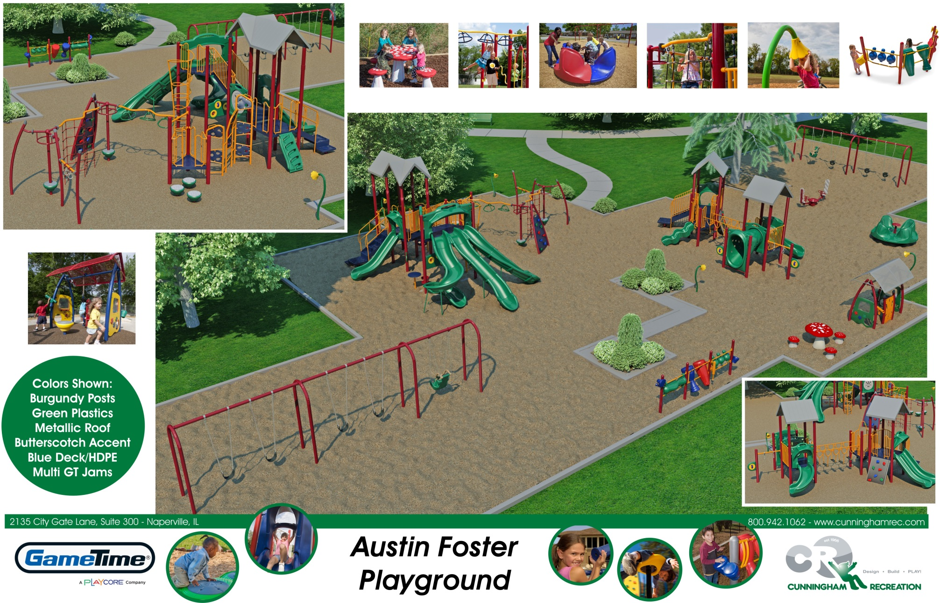
Austin/Foster Playground

Slide 12
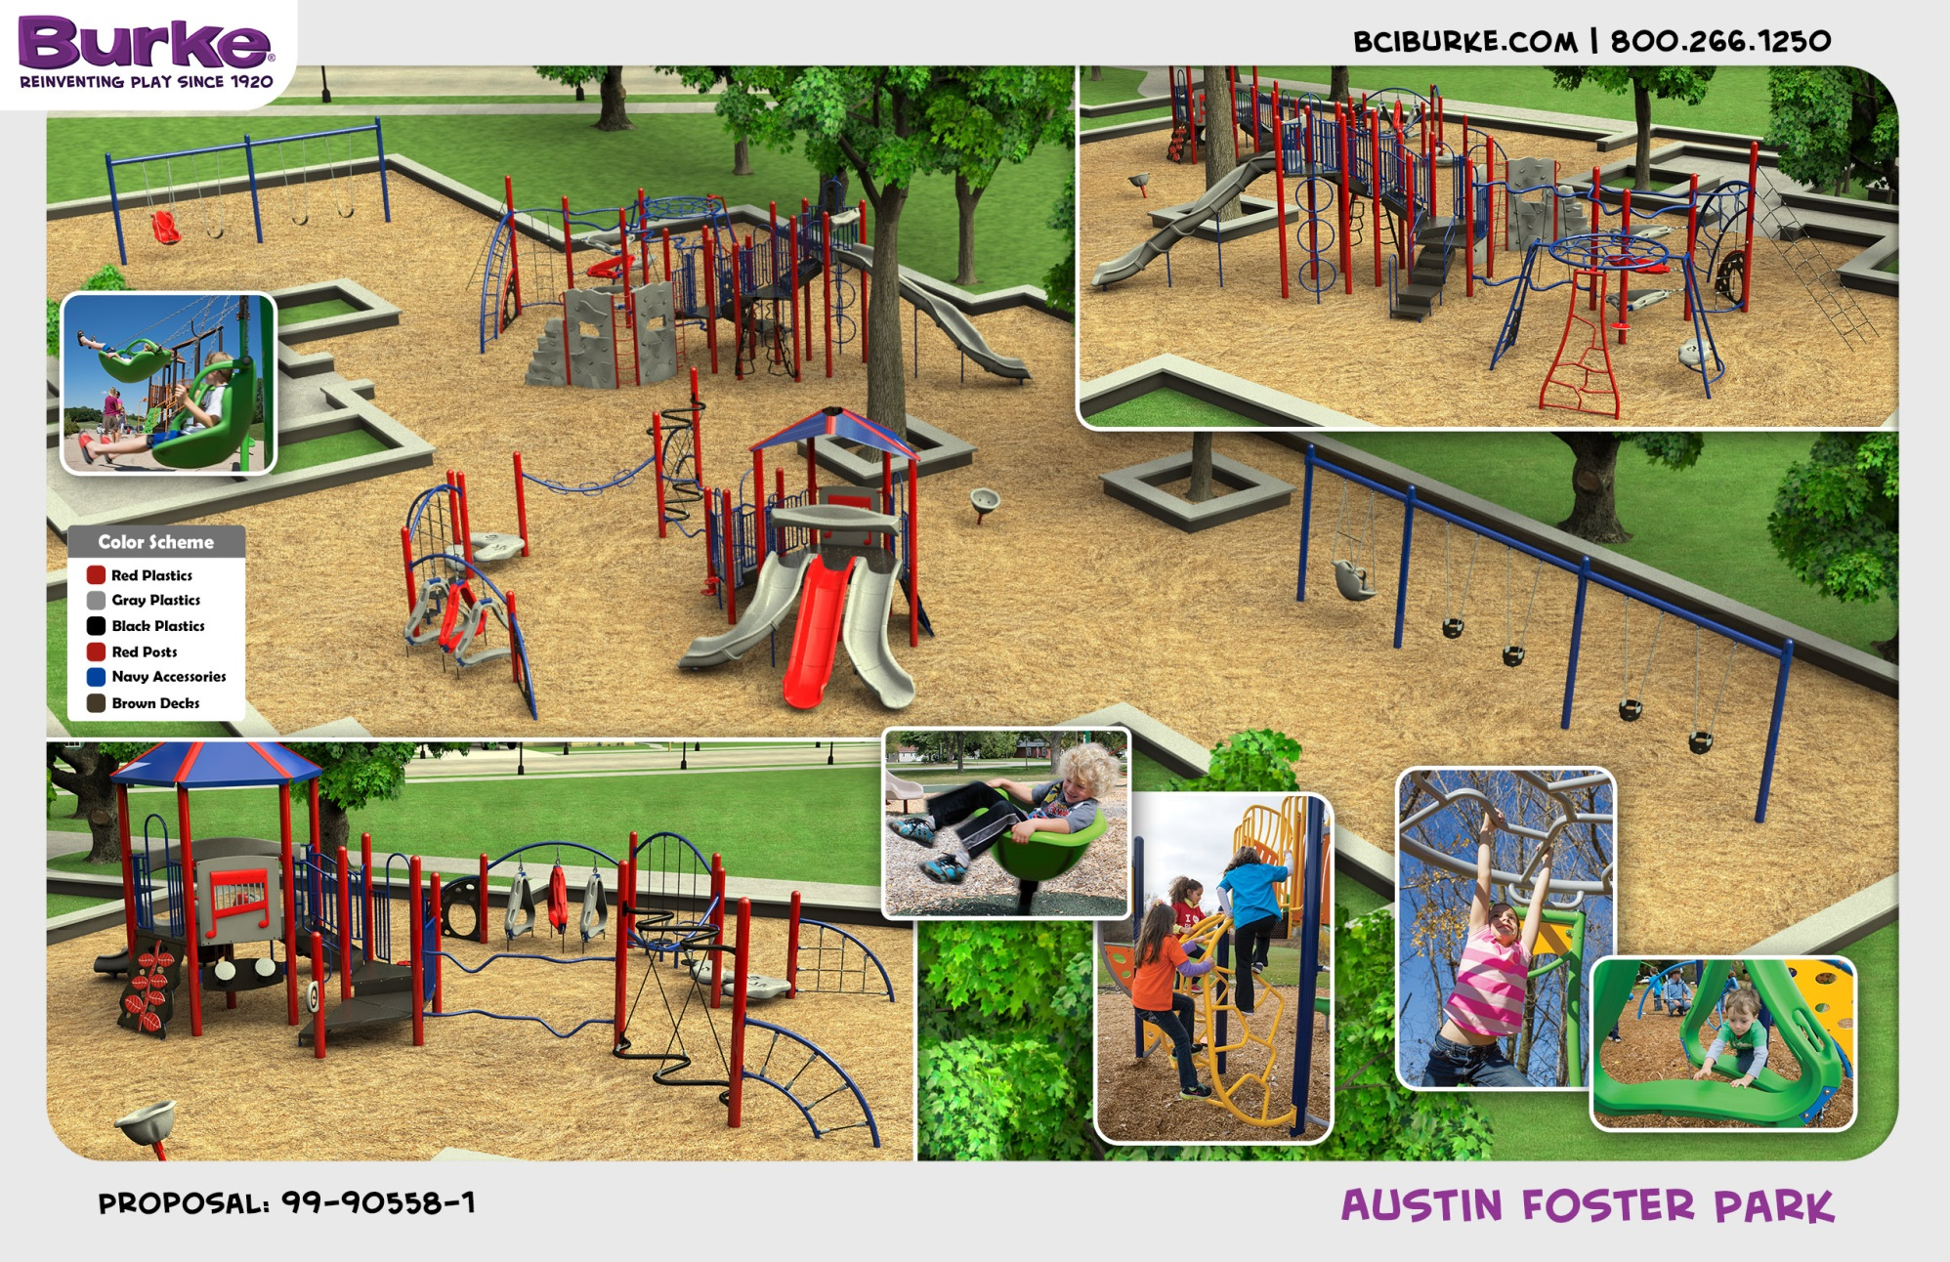
Austin/Foster Playground

Slide 13
New Business
Milwaukee/Higgins Alley
Restaurant Crawl

Slide 14
Next Meeting
Thursday, July 20, 7:00 pm
Location: TBD
Guest Speaker
Commander William Looney, 16th District, Chicago Police Department
Representative Robert Martwick (19th District)

Slide 15
Thank You!

